Slide 1

INSTITUTE : UIE
DEPARTMENT : APEX INSTITUTE OF TECHNOLOGY(CSE)
INDUSTRIAL SUMMER TRAINING
Student Name: VEDANT
Student UID: 20BCS6624
Section: 20AIML 6
Group:B
DISCOVER . LEARN . EMPOWER

Slide 2
Overview
About the company
Why to choose this company
About the project
Learning Outcome
Conclusion

Slide 3
About the Company
a technology company on a mission to equip students with relevant skills & practical exposure to help them get the best possible start to their careers. Imagine a world full of freedom and possibilities. A world where you can discover your passion and turn it into your career. A world where you graduate fully assured, confident, and prepared to stake a claim on your place in the world.
Internshala Student Partner (ISP) is India's largest campus ambassador program where college students get a chance to become the face of Internshala. This program helps students learn, earn & grow at the same time while developing essential marketing and communication skills.

Slide 4
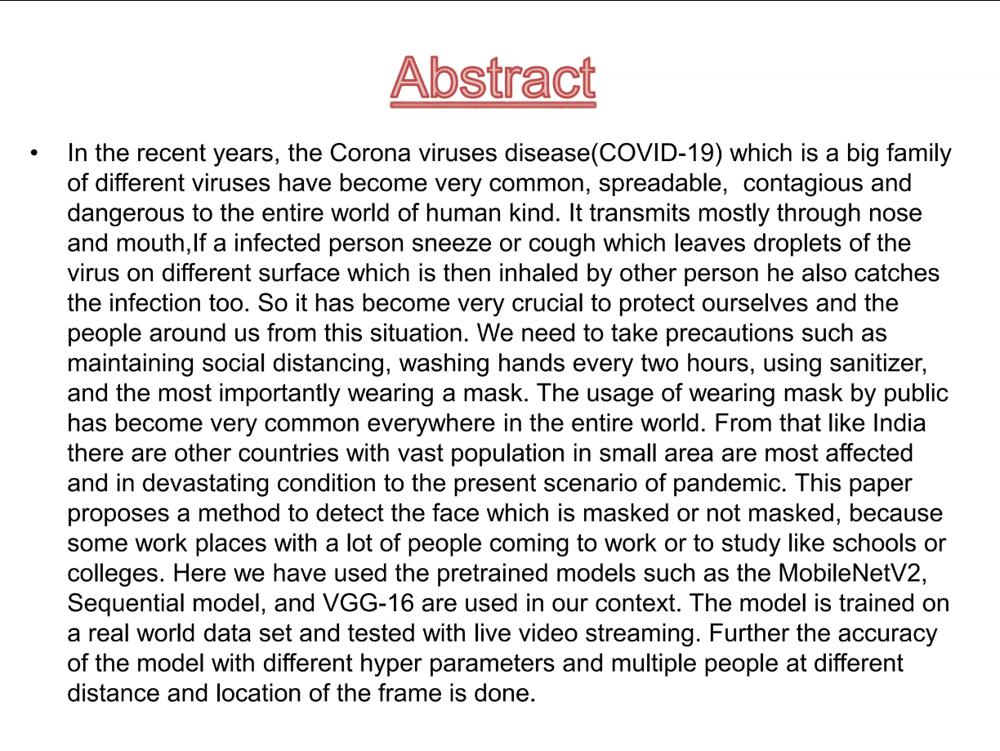
About the project

Slide 5
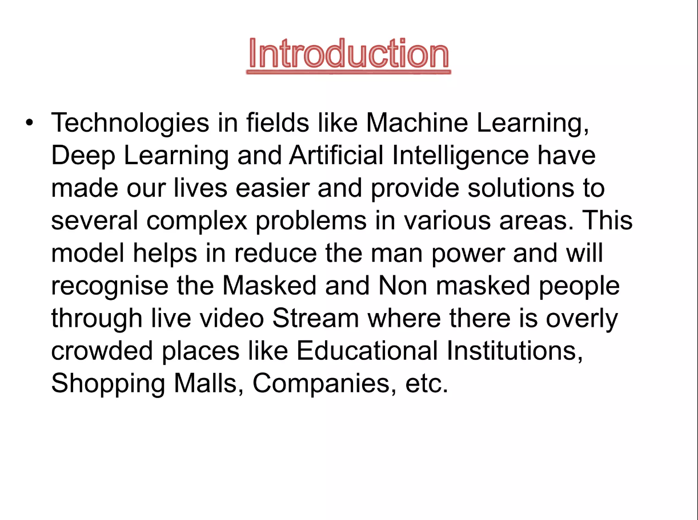

Slide 6
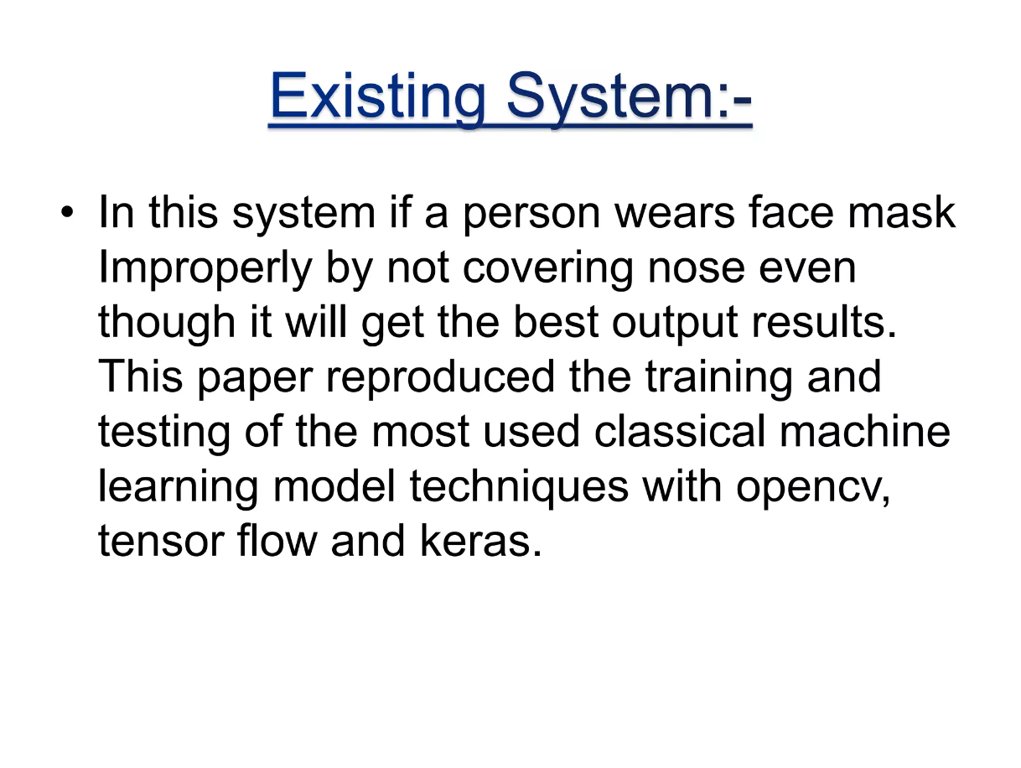

Slide 7
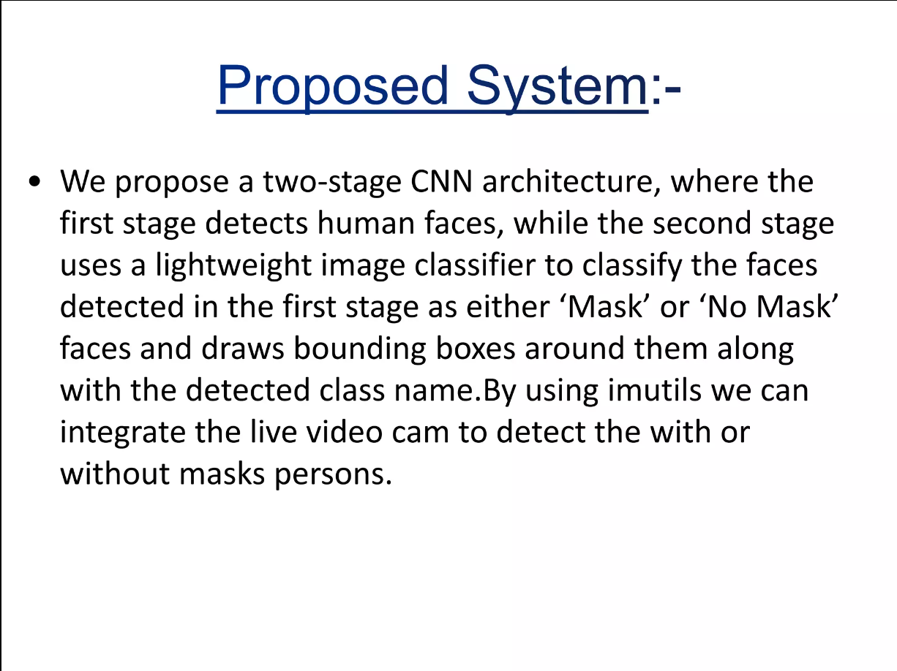

Slide 8
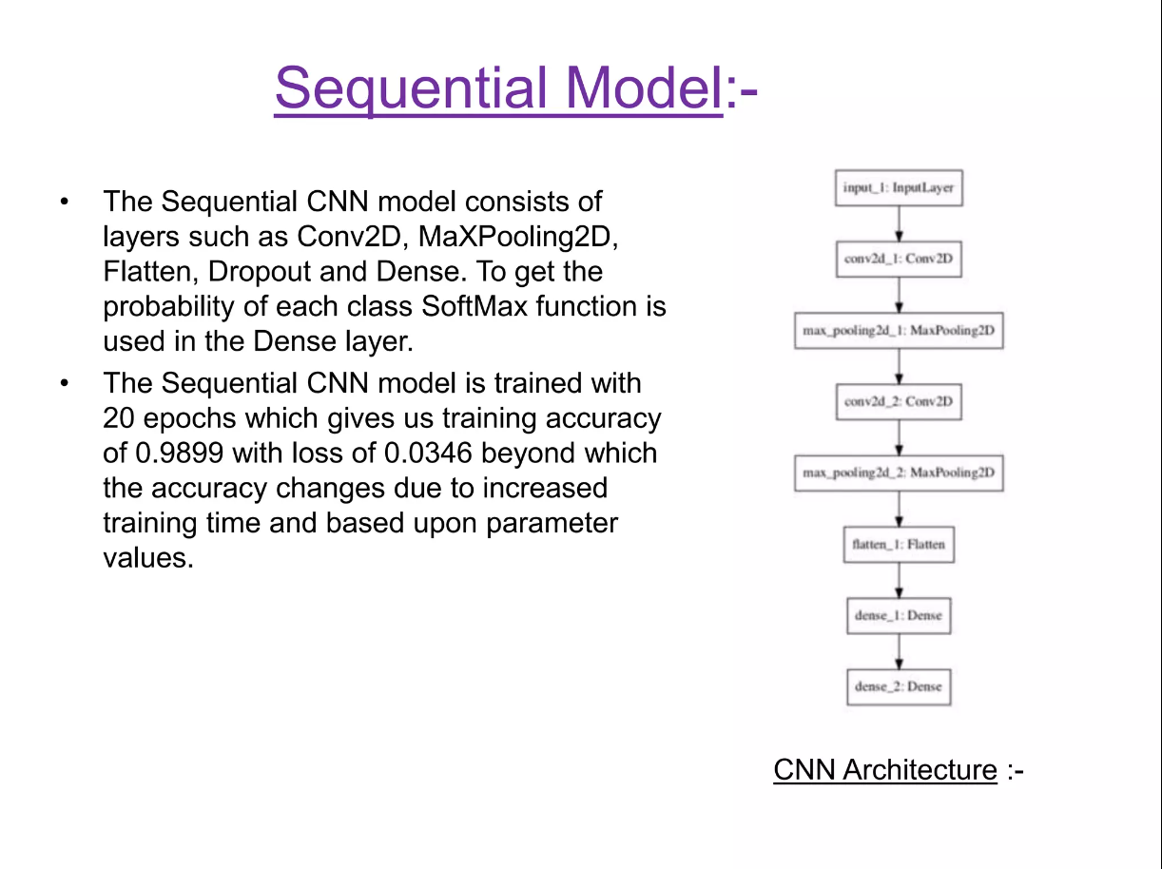

Slide 9
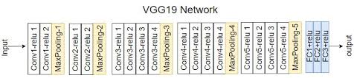
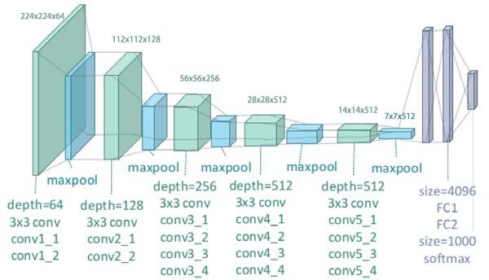

Slide 10
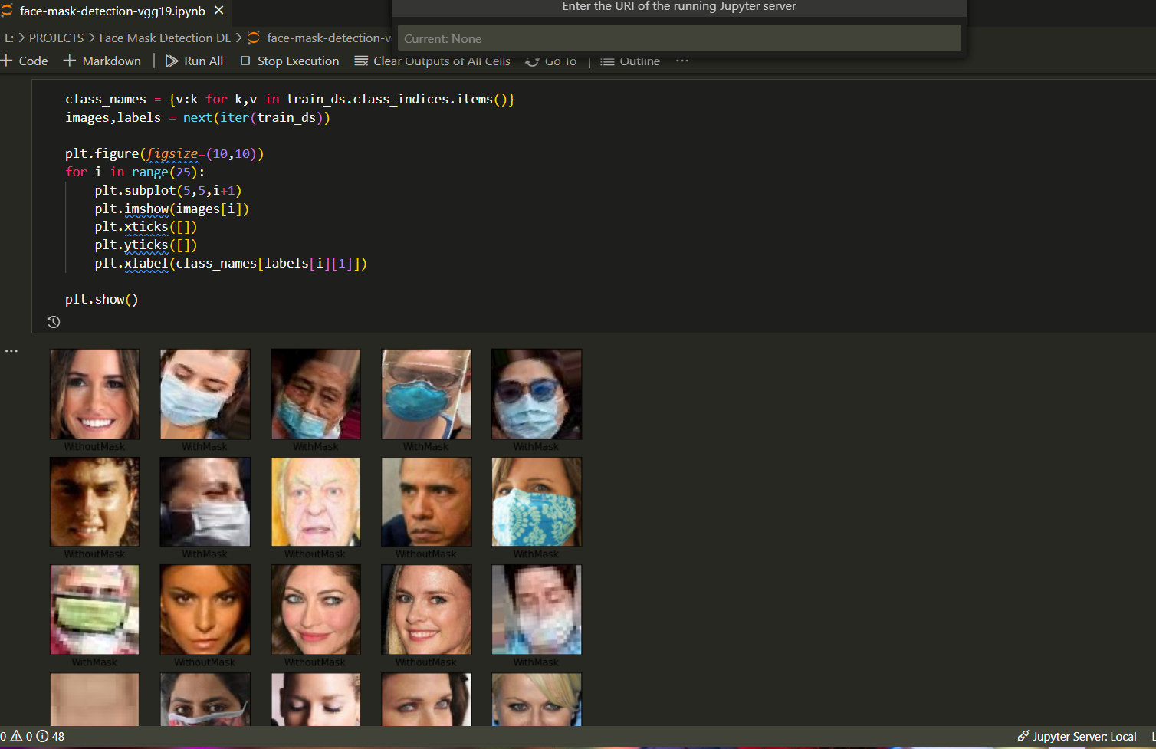

Slide 11
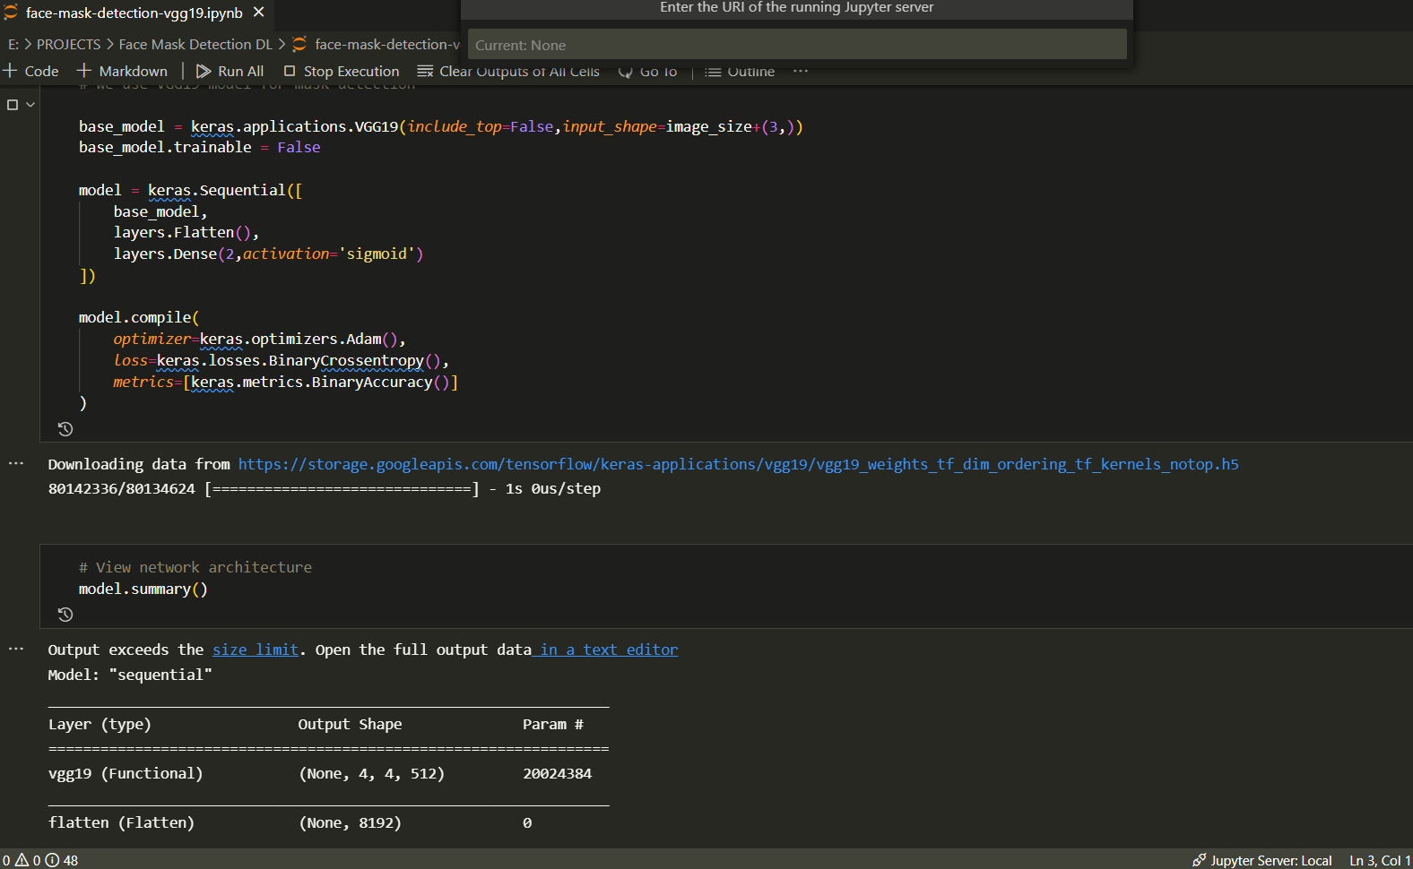

Slide 12
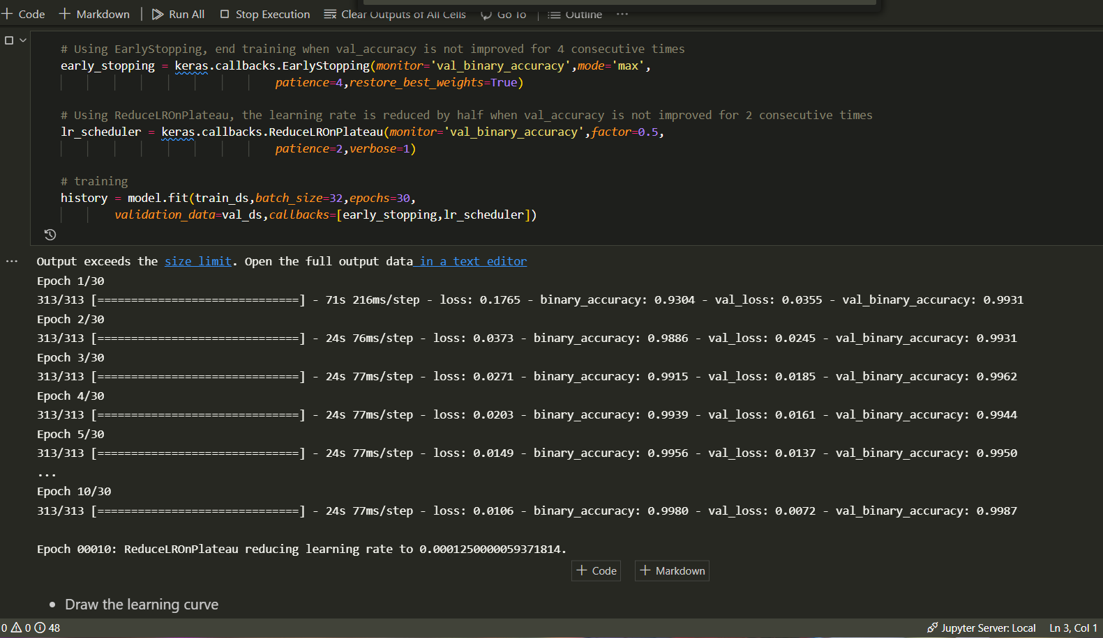

Slide 13
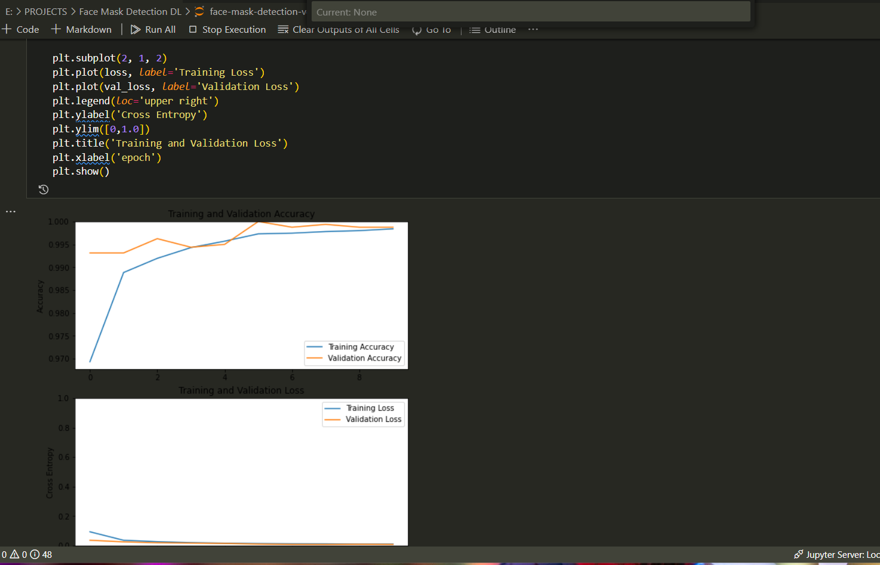

Slide 14
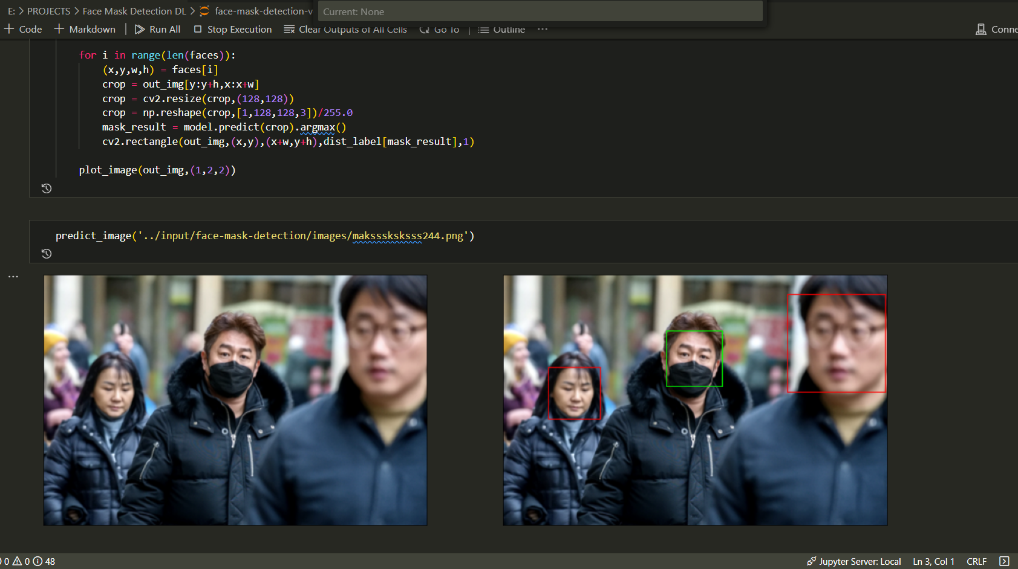

Slide 15
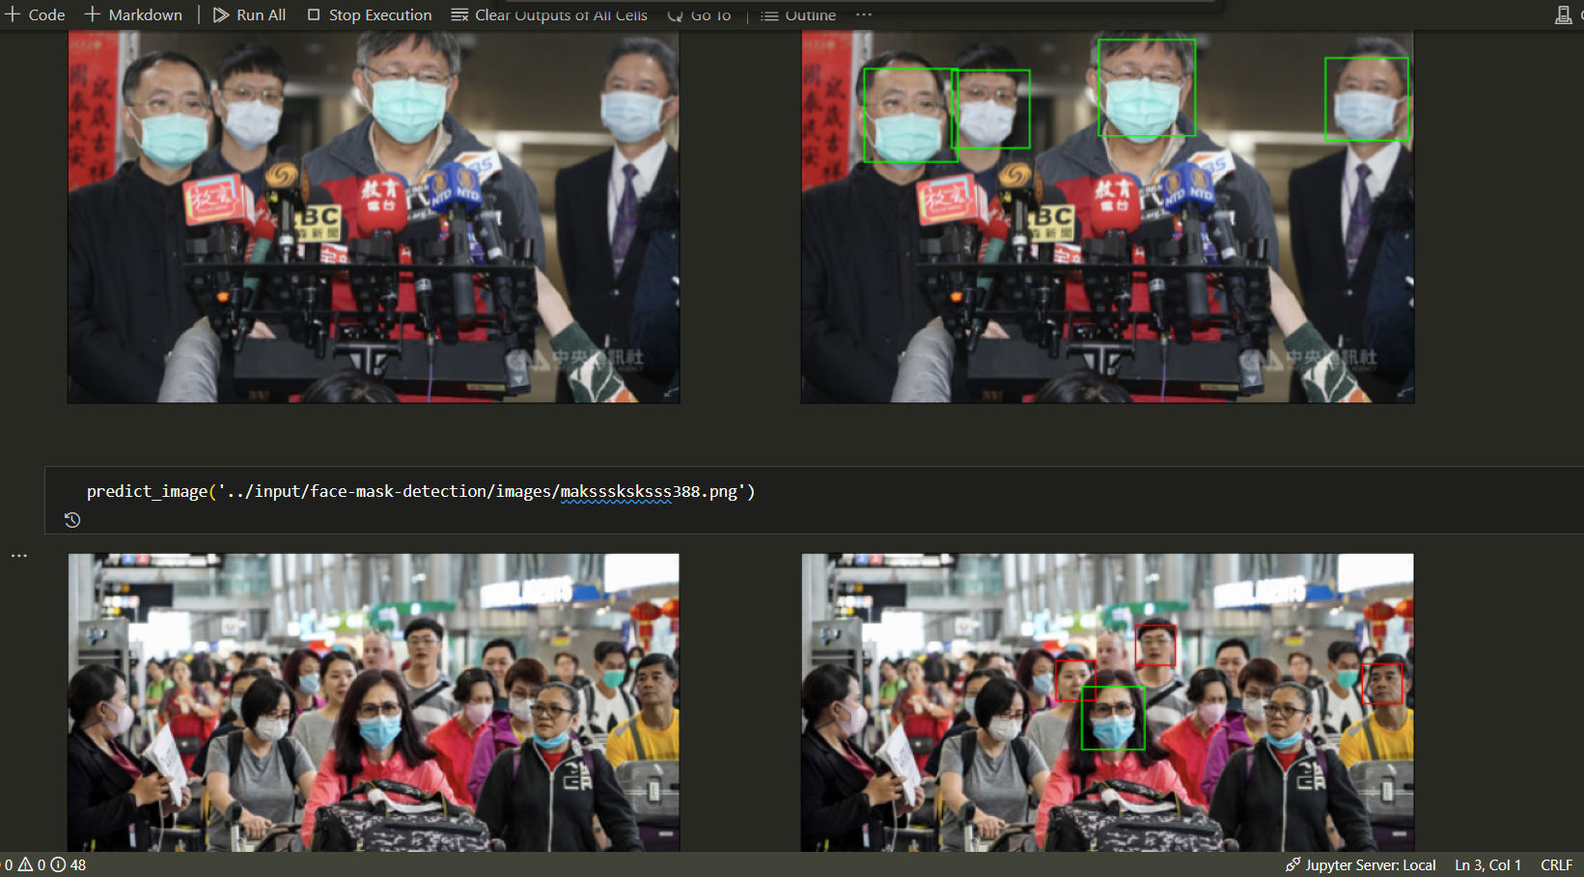

Slide 16
Learning Outcome
After learning DEEP LEARNING from INTERNSHALA TRAININGS, I was able to understand how deep learning and different types of neural networks works. I was able to use transfer learning and the knowledge gained by this course into making a useful project based on DEEP LEARNING
I have successfully made a project named FACE MASK DETECTION using the concepts of transfer learning and using VGG19.
Below a brief look into project

Slide 17
Conclusion
I believe that I have shown conclusively that it is both possible and desirable to use deep learning concepts in making something useful for society in these hard pandemic times.

Slide 18

THANK YOU

